Slide 1
The Relational Data Model and Relational Database Constraints

Slide 2
Relational Model
The relational data model was first introduced by Ted Codd of IBM Research in 1970
The relational model represents the database as a collection of relations.
Informally, each relation resembles a table of values or, to some extent, a flat file of records.
When a relation is thought of as a table of values, each row in the table represents a collection of related data values.
A row represents a fact that typically corresponds to a real-world entity or relationship, the table name and column names are used to help to interpret the meaning of the values in each row.

Slide 3
Domain
A domain D is a set of atomic values. By atomic we mean that each value in the domain is indivisible as far as the formal relational model is concerned.
A common method of specifying a domain is to specify a data type from which the data values forming the domain are drawn.
A data type or format is also specified for each domain. Domain is nothing but a column in table.
Example:
Name: The set of character strings that represent names of persons.
USN: Set of 10 digit number(alphanumeric characters i.e string)
2GI20CS001
A domain is thus given a name, data type, and a format

Slide 4
Relation schema
A relation schema R, denoted by R(A1, A2, … , An), is made up of a relation name R and a list of attributes, A1, A2, … , An.
Each attribute Ai is the name of a role played by some domain D in the relation schema R.
D is called the domain of Ai and is denoted by dom (Ai).
A relation schema is used to describe a relation; R is called the name of this relation.
The degree (or arity) of a relation is the number of attributes n of its relation schema.
Example : STUDENT(USN, NAME, DOB, SEM, ADDRESS, PHNo)
Degree of Relation STUDENT =?

Slide 5
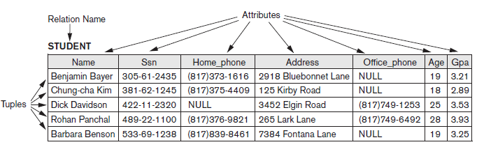
Relation (or relation state)
A relation (or relation state) r of the relation schema R(A1, A2, … , An), also denoted by r(R), is a set of n-tuples r = {t1, t2, … , tm}. Each n-tuple t is an ordered list of n values t = <v1, v2, … , vn>, where each value vi , 1 ≤ i ≤ n, is an element of dom (Ai) or is a special NULL value.

Slide 6
Characteristics of Relations
Ordering of Tuples in a Relation:
A relation is defined as a set of tuples. Mathematically, elements of a set have no order among them; hence, tuples in a relation do not have any particular order.
Tuple ordering is not part of a relation definition because a relation attempts to represent facts at a logical or abstract level
Ordering of Values within a Tuple:
The order of attributes and their values is not that important as long as the correspondence between attributes and values is maintained.
Values and NULLs in the Tuples:
Each value in a tuple is an atomic value; that is, it is not divisible into components within the framework of the basic relational model. Hence, composite and multivalued attributes are not allowed.
Meanings for NULL values, such as value unknown, value exists but is not available, or attribute does not apply(NA) to this tuple.

Slide 7
Relational Database Schemas
A relational database schema S is a set of relation schemas S = {R1, R2, … , Rm} and a set of integrity constraints IC. A relational database state, DB of S is a set of relation states DB = {r1, r2, … , rm} such that each ri is a state of Ri and such that the ri relation states satisfy the integrity constraints specified in IC.

Slide 8
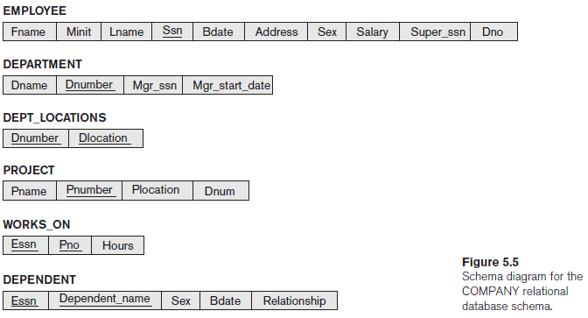
Relational Database Schema Example: A Company Database Schema

Slide 9
Relational Model Constraints
Domain Constraints
Key Constraints and Constraints on NULL Values.
Entity Integrity, Referential Integrity, and Foreign Keys.
Other Types of Constraints- Triggers, assertions

Slide 10
Domain Constraints
Domain constraints specify that within each tuple, the value of each attribute A must be an atomic value from the domain dom (A).
Consider the below example,
STUDENT
Dom(SEM) Is Integer But A String Is Inserted Which Is Violating The Constraint
USN | NAME | DEPT | SEM | MOB
 |  |  | ABC

Slide 11

Entity Integrity
The entity integrity constraint states that no primary key value can be NULL.
This is because the primary key value is used to identify individual tuples in a relation. Having NULL values for the primary key implies that we cannot identify some tuples.
Key constraints and entity integrity constraints are specified on individual relations.
STUDENT
USN | NAME | DEPT | SEM | MOB
NULL

Slide 12
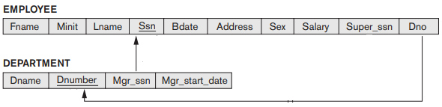
Referential Integrity
The referential integrity constraint is specified between two relations and is used to maintain the consistency among tuples in the two relations.
Informally, the referential integrity constraint states that a tuple in one relation that refers to another relation must refer to an existing tuple in that relation.
Example:

Slide 13
Update Operations
There are three basic operations that can change the states of relations in the database: Insert, Delete, and Update (or Modify).
Insert is used to insert one or more new tuples in a relation
Delete is used to delete tuples
Update (or Modify) is used to change the values of some attributes in existing tuples.
Whenever these operations are applied, the integrity constraints specified on the relational database schema should not be violated.

Slide 14
The Insert Operation
Constraint Violation in Relational Model
The Insert can violate any of the four types of constraints.
Domain constraints can be violated if an attribute value is given that does not appear in the corresponding domain or is not of the appropriate data type.
Key constraints can be violated if a key value in the new tuple t already exists in another tuple in the relation r(R).
Entity integrity can be violated if any part of the primary key of the new tuple ‘t’ is NULL.
Referential integrity can be violated if the value of any foreign key in ‘t’ refers to a tuple that does not exist in the referenced relation.

Slide 15
Example for constraint violation – insert operation
EMPLOYEE
DEPARTMENT
EID | ENAME | AGE | GENDER | SALARY | DID
11 | ANIL | 27 | M | 65000 | 1
12 | BIPIN | 23 | M | 55000 | 2
13 | DIYA | 25 | F | 65000 | 1
14 | RAVI | 24 | M | 25000 | 2
15 | VINUTH | 27 | M | 25000 | 3
DID | DNAME | DHEAD
1 | DESIGN | BIPIN
2 | SALES | RAVI
3 | ACCOUNT | UTTAM
4 | PRODUCTION | DIYA
Identify which constraints are violated by the below insert statements?
INSERT INTO EMPLOYEE VALUES(NULL, ‘AMIT’,23,’M’,45000,3);
INSERT INTO EMPLOYEE VALUES(13, ‘ARUN’,25,’M’,45000,2);
INSERT INTO EMPLOYEE VALUES(16, ‘ARYA’,22,’M’,75000,5);
INSERT INTO EMPLOYEE VALUES(17, ‘SURYA’,33,2,75000,1);

Slide 16
The Delete Operation
The Delete operation can violate only referential integrity.
This occurs if the tuple being deleted is referenced by foreign keys from other tuples in the database.
To specify deletion, a condition on the attributes of the relation selects the tuple (or tuples) to be deleted
Several options are available if a deletion operation causes a violation. The first option, called restrict, is to reject the deletion.
The second option, called cascade, is to attempt to cascade (or propagate) the deletion by deleting tuples that reference the tuple that is being deleted.
Example:
DELETE FROM DEPARTMENT WHERE DID = 4
DELETE FROM DEPARTMENT WHERE DID =1

Slide 17
The Update Operation
Updating an attribute that is neither part of a primary key nor part of a foreign key usually causes no problems; the DBMS need only check to confirm that the new value is of the correct data type and domain.
Modifying a primary key value is similar to deleting one tuple and inserting another in its place because we use the primary key to identify tuples.
DBMS must make sure that the new value refers to an existing tuple in the referenced relation (or is set to NULL). Similar options exist to deal with referential integrity violations caused by Update as those options discussed for the Delete operation.

Slide 18
Relational Algebra:
The two formal languages for the relational model:
Relational algebra
Relational calculus
Practical language for the relational model
SQL based on concepts of the above formal languages.
The basic set of operations for the relational model is the relational algebra. These operations enable a user to specify basic retrieval requests as relational algebra expressions.

Slide 19
Importance of Relational Algebra
First, it provides a formal foundation for relational model operations in the form of relational algebra expressions.
Second, it is used as a basis for implementing and optimizing queries in the query processing and optimization modules that are integral parts of relational database management systems.
Third, some of its concepts are incorporated into the SQL standard query language for RDBMSs

Slide 20
Relational Algebra
It is considered to be an integral part of the relational data model. Its operations can be divided into two groups.
First group includes set operations from mathematical set theory; these are applicable because each relation is defined to be a set of tuples in the formal relational model. Set operations include UNION, INTERSECTION, SET DIFFERENCE, and CARTESIAN PRODUCT.
Second group consists of operations developed specifically for relational databases—these include SELECT, PROJECT, and JOIN.
Other group includes- aggregate functions.

Slide 21
Relational Algebra Operators
Basic Operators
Select(σ)
Project(∏)
Union(∪)
Set difference(−)
Cartesian product(Χ)
Rename(ρ)

Slide 22
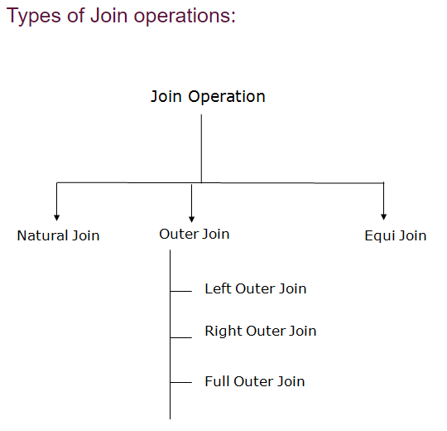
Derived Operators
⋈

Slide 23
Contnd…
Intersection(∩)
Division(÷ or /)

Slide 24
Unary Relational Operations: SELECT and PROJECT
Select is used to choose a subset of the tuples from a relation that satisfies a selection condition. One can consider the SELECT operation to be a filter that keeps only those tuples that satisfy a qualifying condition.
Alternatively, we can consider the SELECT operation to restrict the tuples in a relation to only those tuples that satisfy the condition.
The SELECT operation can also be visualized as a horizontal partition of the relation into two sets of tuples—those tuples that satisfy the condition and are selected, and those tuples that do not satisfy the condition and are discarded.

Slide 25
SELECT (σ)
In general, the SELECT operation is denoted by
σ<selection condition>(R)
where the symbol σ (sigma) is used to denote the SELECT operator and the selection condition is a Boolean expression (condition) specified on the attributes of relation R.
The Boolean expression specified in <selection condition> is made up of a number of clauses of the form
<attribute name> <comparison op> <constant value>
or
<attribute name> <comparison op> <attribute name>
Example: 1. σ Dno=4(EMPLOYEE)
2. σ Salary>30000(EMPLOYEE)

Slide 26
SELECT (σ)
Find the employees who work for department no 4 and draw salary more than 25000.
σ Dno=4 AND Salary>25000 (EMPLOYEE)
SQL query:
SELECT *
FROM EMPLOYEE
WHERE Dno=4 AND Salary>25000;

Slide 27
PROJECT Operation
The SELECT operation chooses some of the rows from the table while discarding other rows. The PROJECT operation, on the other hand, selects certain columns from the table and discards the other columns.
If we are interested in only certain attributes of a relation, we use the PROJECT operation to project the relation over these attributes only.
The result of the PROJECT operation can be visualized as a vertical partition of the relation into two relations.

Slide 28
PROJECT(π)
The general form of the PROJECT operation is
π<attribute list>(R)
where π (pi) is the symbol used to represent the PROJECT operation, and <attribute list> is the desired sublist of attributes from the attributes of relation R.
Example:
π Lname, Fname, Salary(EMPLOYEE)
The PROJECT operation removes any duplicate tuples, so the result of the PROJECT operation is a set of distinct tuples.

Slide 29
PROJECT(π)
Find the employee names, salary and their dept numbers for which they are working.
π Ename, Salary, Did (EMPLOYEE)
SQL Query:
Select Distinct Ename, Salary, Did
From Employee.

Slide 30
Sequences of Operations and the RENAME Operation
In general, for most queries, we need to apply several relational algebra operations one after the other.
We can write the operations as a single relational algebra expression by nesting the operations, or we can apply one operation at a time and create intermediate result relations.
In the latter case, we must give names to the relations that hold the intermediate results

Slide 31
Example:
Write relational algebraic expression to retrieve the first name, last name, and salary of all employees who work in department number 5.
Method 1: by nesting the operations
πFname, Lname, Salary(σDno=5(EMPLOYEE))
Method 2: Renaming and creating intermediate result relation- one operation at a time.
DEP5_EMPS ← σDno=5(EMPLOYEE)
RESULT ← πFname, Lname, Salary(DEP5_EMPS)

Slide 32
To rename the attributes in a relation, we simply list the new attribute names in parentheses, as in the following example:
TEMP ← σDno=5(EMPLOYEE)
R( First_name, Last_name, Salary) ← π Fname, Lname, Salary(TEMP)
We can also define a formal RENAME operation—which can rename either the relation name or the attribute names, or both—as a unary operator.
ρS(B1, B2, ..., Bn)(R) or ρS(R) or ρ(B1, B2, ..., Bn)(R)
where the symbol ρ (rho) is used to denote the RENAME operator, S is the new relation name, and B1, B2, ..., Bn are the new attribute names.
Renaming in SQL is accomplished by aliasing using AS, as in the following example:
SELECT E.Fname AS First_name, E.Lname AS Last_name
FROM EMPLOYEE

Slide 33
Relational Algebra Operations from Set Theory
UNION, INTERSECTION, and MINUS Operations.
These are binary operations; that is, each is applied to two sets (of tuples).
The two relations on which any of these three operations are applied must have the same type of tuples, this condition has been called union compatibility or type compatibility.
Two relations R(A1, A2, … , An) and S(B1, B2, … , Bn) are said to be union compatible (or type compatible) if they have the same degree n and if dom(Ai) = dom(Bi) for 1 ≤ i ≤ n.

Slide 34
We can define the three operations UNION, INTERSECTION, and SET DIFFERENCE on two union-compatible relations R and S as follows:
UNION: The result of this operation, denoted by R ∪ S, is a relation that includes all tuples that are either in R or in S or in both R and S. Duplicate tuples are eliminated.
INTERSECTION: The result of this operation, denoted by R ∩ S, is a relation that includes all tuples that are in both R and S.
SET DIFFERENCE (or MINUS OR EXCEPT): The result of this operation, denoted by R – S, is a relation that includes all tuples that are in R but not in S.

Slide 35
Notice that both UNION and INTERSECTION are commutative operations; that is,
R ∪ S = S ∪ R and R ∩ S = S ∩ R
Both UNION and INTERSECTION can be treated as n- ary operations applicable to any number of relations because both are also associative operations; that is,
R ∪ (S ∪ T ) = (R ∪ S) ∪ T and (R ∩ S) ∩ T = R ∩ (S ∩ T)
The MINUS operation is not commutative; that is,
In general, R − S ≠ S − R
Note that INTERSECTION can be expressed in terms of union and set difference as follows:
R ∩ S = ((R ∪ S) − (R − S)) − (S − R)

Slide 36
Retrieve the Social Security numbers of all employees who either work in department 5 or directly supervise an employee who works in department 5.
DEP5_EMPS ← σ Dno=5(EMPLOYEE)
RESULT1 ← π Ssn(DEP5_EMPS)
RESULT2( Ssn ) ← π Super_ssn(DEP5_EMPS)
RESULT ← RESULT1 ∪ RESULT2

Slide 37
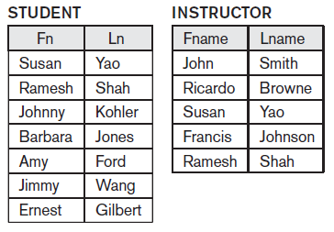
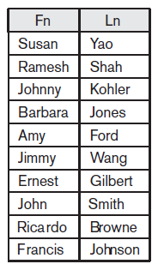
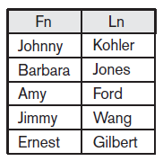
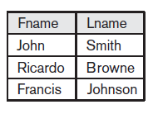
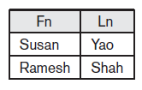

Slide 38
CARTESIAN PRODUCT (CROSS PRODUCT)
It’s a binary set operation, also known as CROSS PRODUCT or CROSS JOIN—which is denoted by ×.
Relations do not have to be union compatible.
This set operation produces a new element by combining every member (tuple) from one relation (set) with every member (tuple) from the other relation (set).
In general, the result of R(A1, A2, ..., An) × S(B1, B2, ..., Bm) is a relation Q with degree n + m attributes Q(A1, A2, ..., An, B1, B2, ..., Bm), in that order. The resulting relation Q has one tuple for each combination of tuples—one from R and one from S.
Hence, if R has nR tuples (denoted as |R| = nR), and S has nS tuples, then R × S will have nR * nS tuples.

Slide 39
For example, suppose that we want to retrieve a list of names of each female employee’s dependents. We can do this as follows:
FEMALE_EMPS ← σ Gender=‘F’(EMPLOYEE)
EMPNAMES ← π Fname, Lname, Ssn (FEMALE_EMPS)
EMP_DEPENDENTS ← EMPNAMES × DEPENDENT
ACTUAL_DEPENDENTS←σ Ssn= Essn (EMP_DEPENDENTS)
RESULT ← π Fname, Lname, Dependent_name(ACTUAL_DEPENDENTS)

Slide 40
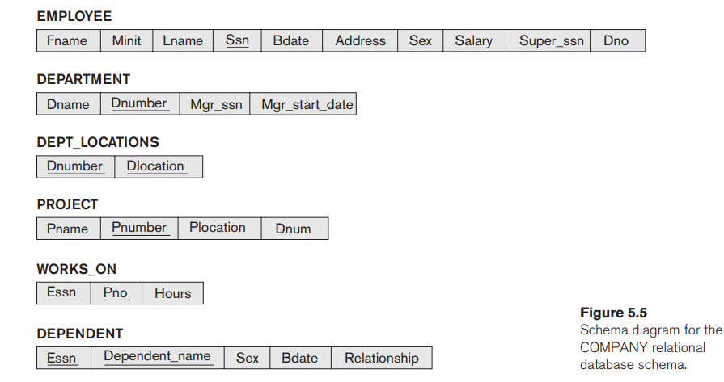
Example: Company Database Schemas

Slide 41

Binary Relational Operations: JOIN & DIVISION
The JOIN operation, denoted by , ∞ is used to combine related tuples from two relations into single “longer” tuples.
Example: Retrieve the name of the manager of each department.
DEPT_MGR ← DEPARTMENT ∞ Mgr_ssn =Ssn EMPLOYEE
RESULT ← π Dname, Lname, Fname(DEPT_MGR)
The JOIN operation can be specified as a CARTESIAN PRODUCT operation followed by a SELECT operation.
DEPT_MGR ← DEPARTMENT X EMPLOYEE
MGRS ← σ Mgr_ssn = Ssn(DEPT_MGR)

Slide 42
The general form of a JOIN operation on two relations R(A1, A2, ..., An) and S(B1,B2, ..., Bm) is
R ∞ <join condition> S
The result of the JOIN is a relation Q with n + m attributes Q(A1, A2, ..., An, B1, B2, ... , Bm) in that order; Q has one tuple for each combination of tuples—one from R and one from S—whenever the combination satisfies the join condition.
A general join condition is of the form,
<condition> AND <condition> AND...AND <condition>
where each <condition> is of the form Ai θ Bj, Ai is an attribute of R, Bj is an attribute of S, Ai and Bj have the same domain, and θ (theta) is one of the comparison operators {=, <, ≤, >, ≥, ≠}.

Slide 43
Join Types:
Theta join(θ) : is a general join condition specified by using any comparison operator(=, <, ≤, >, ≥, ≠).
Equi-join (=): involves join condition specified by equality operator
Natural join (star *): Requires that both relations should have same column name. It was created to get rid of the second (superfluous) attribute in an EQUIJOIN condition.

Slide 44
Product(PName, Price) Component(PName, CName, Cost)
================== =============================
Laptop, 1500 Laptop, CPU, 500
Car , 20000 Laptop, hdd, 300
Airplane, 3000000 Laptop, case, 700
Car, wheels, 1000
Product X Component
| PNAME | PRICE | CNAME | COST |
------------------------------------------------
| Laptop | 1500 | CPU | 500 |
| Laptop | 1500 | hdd | 300 |
| Laptop | 1500 | case | 700 |
| Laptop | 1500 | wheels | 1000 |
| Car | 20000 | CPU | 500 |
| Car | 20000 | hdd | 300 |
| Car | 20000 | case | 700 |
| Car | 20000 | wheels | 1000 |
| Airplane | 3000000 | CPU | 500 |
| Airplane | 3000000 | hdd | 300 |
| Airplane | 3000000 | case | 700 |
| Airplane | 3000000 | wheels | 1000 |

Slide 45
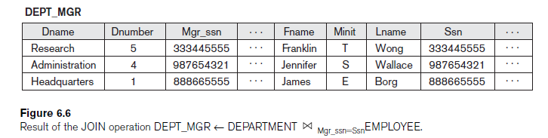
DEPT_MGR ← DEPARTMENT ∞ Mgr_ssn=Ssn EMPLOYEE
RESULT ← πDname, Lname, Fname(DEPT_MGR)

Slide 46
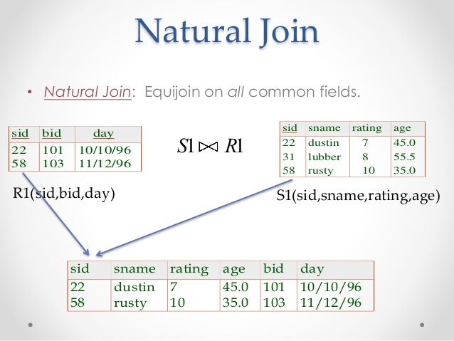

Slide 47
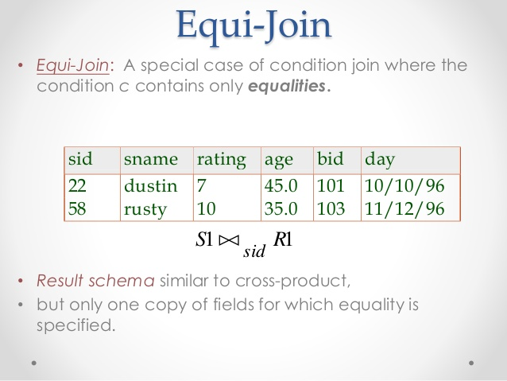

Slide 48
Retrieve the name and address of all employees who work for the ‘Research’ department.
RESEARCH_DEPT ← σDname=‘Research’(DEPARTMENT)
RESEARCH_EMPS ← (RESEARCH_DEPT ∞
Dnumber=DnoEMPLOYEE)
RESULT ← πFname, Lname, Address(RESEARCH_EMPS)
Single line: π Fname, Lname,
Address(σDname=‘Research’(DEPARTMENT ∞ Dnumber=Dno(EMPLOYEE))
SELECT FNAME,LNAME,ADDRESS
FROM EMPLOYEE, DEPARTMENT
WHERE DNAME=‘RESEARCH’ AND DNUMBER=DNO

Slide 49
For every project located in ‘Stafford’, list the project number, the controlling department number, and the department manager’s last name, address, and birth date.
STAFFORD_PROJS ← σPlocation=‘Stafford’ (PROJECT)
CONTR_DEPTS ← (STAFFORD_PROJS ∞
Dnum=Dnumber DEPARTMENT)
PROJ_DEPT_MGRS ← (CONTR_DEPTS ∞
Mgr_ssn=Ssn EMPLOYEE)
RESULT ← π Pnumber, Dnum, Lname, Address, Bdate
(PROJ_DEPT_MGRS)
SELECT PNUMBER, DNUM, LNAME, ADDRESS, BDATE
FROM EMPLOYEE, DEPARTMENT, PROJECT
WHERE PLOCATION=‘STAFFORD’, DNUM=DNUMBER,MGRSSN=SSN

Slide 50
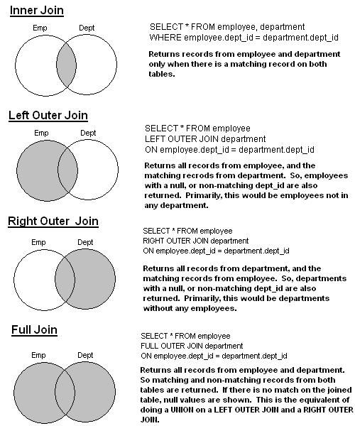

Slide 51
OUTER JOIN Operations in SQL
Join facilitates the retrieval of information from multiple tables
INNER JOIN
LEFT OUTER JOIN
RIGHT OUTER JOIN
FULL OUTER JOIN

Slide 52
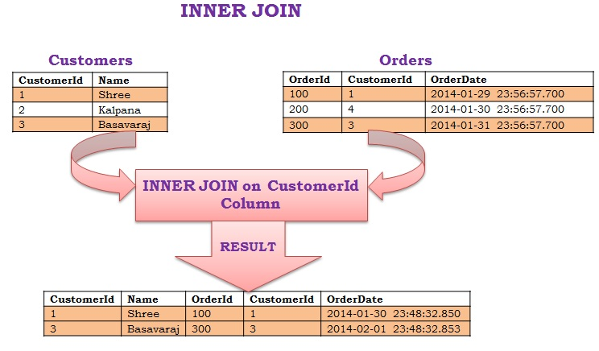
Inner Join returns only the matching rows in both the tables (i.e. returns only those rows for which the join condition satisfies)

Slide 53
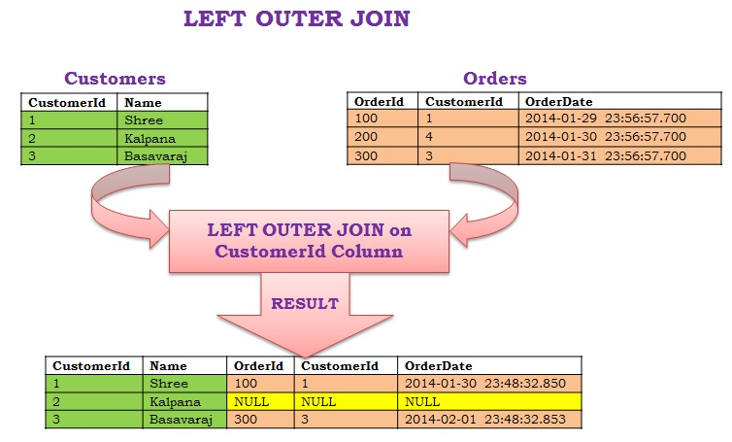
Left Outer Join/Left Join returns all the rows from the LEFT table and the corresponding matching rows from the right table. If right table doesn’t have the matching record then for such records right table column will have NULL value in the result.

Slide 54
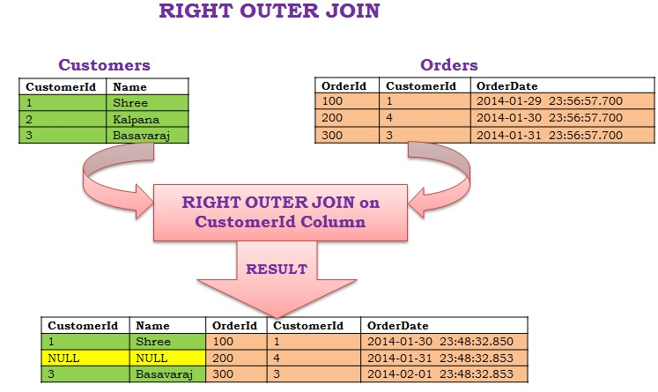
Right Outer Join/Right Join returns all the rows from the RIGHT table and the corresponding matching rows from the left table. If left table doesn’t have the matching record then for such records left table column will have NULL value in the result.

Slide 55
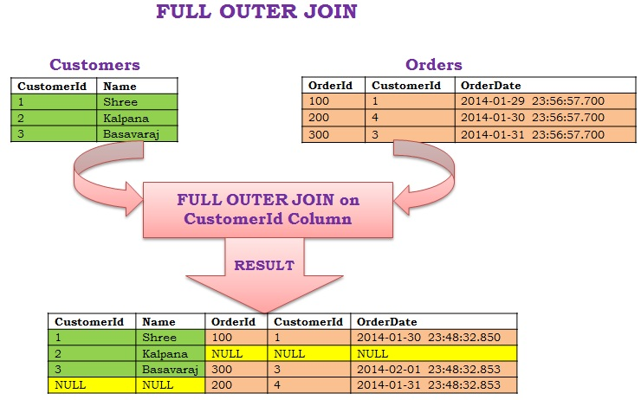
It returns all the rows from both the tables, if there is no matching row in either of the sides then it displays NULL values in the result for that table columns in such rows.

Slide 56
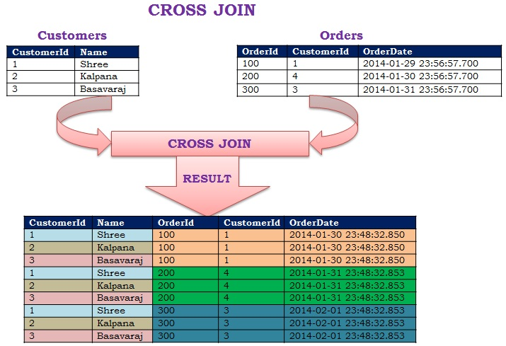
Cross join is also referred to as Cartesian Product. For every row in the LEFT Table of the CROSS JOIN all the rows from the RIGHT table are returned and Vice-Versa (i.e.result will have the Cartesian product of the rows from join tables).

Slide 57
BANK DATABASE SCHEMA:
BRANCH(BNAME,BCITY,ASSETS)
CUSTOMER(CNAME,CSTREET,CCITY)
ACCOUNT(ACC_NO,BNAME,BALANCE)
LOAN(LOAN_NO,BNAME,AMOUNT)
DEPOSITOR(CNAME,ACC_NO)
BORROWER(CNAME,LOAN_NO)

Slide 58
Company Schema
Dept(Dnum,Dname,MgrSsn,Mgrstdate)
Emp (Ssn,Name,Bdate,Address,Gender,Salary,Super_Ssn,Dno)
Project(Pnum,Pname,Ploc,Dnum)

Slide 59
The DIVISION Operation(÷)
An example is Retrieve the names of employees who work on all the projects that ‘John Smith’ works on.
SMITH ← σ Fname=‘John’ AND Lname=‘Smith’(EMPLOYEE)
SMITH_PNOS ← π Pno(WORKS_ON Essn = Ssn SMITH)
SSN_PNOS ← π Essn, Pno(WORKS_ON)
SSNS( Ssn ) ← SSN_PNOS ÷ SMITH_PNOS
RESULT ← π Fname, Lname(SSNS * EMPLOYEE)

Slide 60
DIVISION operation is applied to two relations R(Z) ÷ S(X), where the attributes of S are a subset of the attributes of R; that is, X ⊆ Z.
Attributes in Result of Division operations are Attributes of R - Attributes of S
The result of DIVISION is a relation T(Y) that includes a tuple t if tuples tR appear in R with tR [Y] = t, and with tR [X] = tS for every tuple tS in S.
This means that, for a tuple t to appear in the result T of the DIVISION, the values in t must appear in R in combination with every tuple in S

Slide 61
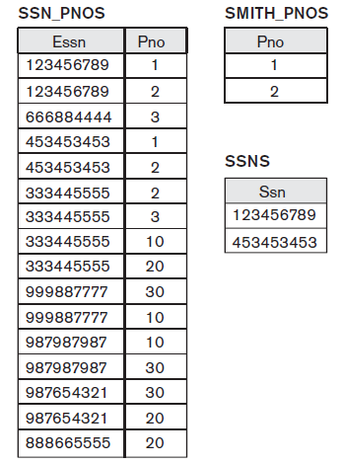
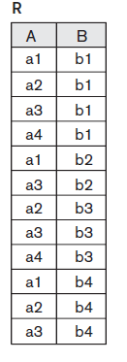



Slide 62
Aggregate Functions and Grouping
Aggregate Functions (ℑ):
<grouping attributes> ℑ <function list> (R)
where <grouping attributes> is a list of attributes of the relation specified in R, and <function list> is a list of (<function> <attribute>) pairs. In each such pair, <function> is one of the allowed functions—such as SUM, AVERAGE, MAXIMUM, MINIMUM,COUNT—and <attribute> is an attribute of the relation specified by R.
Q: Retrive each dept no., the no. of emp in the dept, and their avg salary, while renaming the resulting attributes

Slide 63
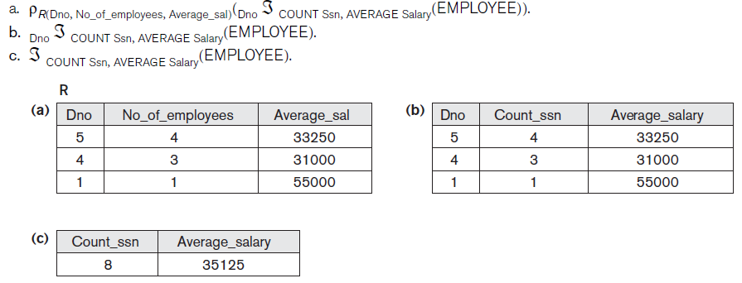
a. ρR(Dno, No_of_employees, Average_sal)(Dno ℑ COUNT Ssn, AVERAGE Salary(EMPLOYEE)).
b. Dno ℑ COUNT Ssn, AVERAGE Salary(EMPLOYEE).
c. ℑ COUNT Ssn, AVERAGE Salary(EMPLOYEE).

Slide 64
Example: Company Database Schemas

Slide 65
Find the names of employees who work on all the projects controlled by department number 5.
DEPT5_PROJS ← ρ(Pno)(πPnumber(σDnum=5(PROJECT)))
EMP_PROJ ← ρ(Ssn, Pno)(πEssn, Pno(WORKS_ON))
RESULT_EMP_SSNS ← EMP_PROJ ÷ DEPT5_PROJS
RESULT ← πLname, Fname(RESULT_EMP_SSNS * EMPLOYEE)

Slide 66
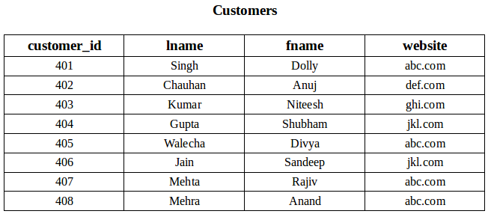
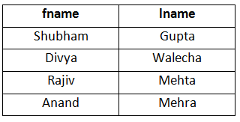
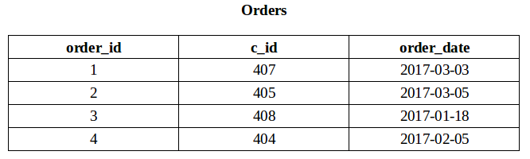
To fetch the first and last name of the customers who has placed atleast one order.
SELECT fname, lname
FROM Customers
WHERE EXISTS (SELECT * FROM Orders
WHERE
Customers.customer_id = Orders.c_id);

Slide 67
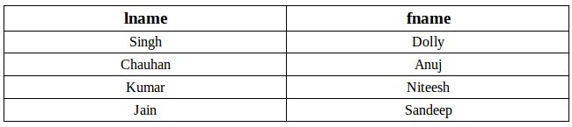
Fetch last and first name of the customers who has not placed any order.
SELECT lname, fname
FROM Customer
WHERE NOT EXISTS (SELECT * FROM Orders
WHERE Customers.customer_id = Orders.c_id);

Slide 68
List the names of all employees with two or more dependents.
T1( Ssn, No_of_dependents)← Essn ℑ COUNT Dependent_name (DEPENDENT)
T2 ← σ No_of_dependents >2 (T1)
RESULT ← π Lname, Fname (T2 * EMPLOYEE)

